Slide 1
SkyArt Networks Company Ltd
Business Overview
Skyart Networks Limited is a fixed wireless internet service provider (WISP) focused on delivering affordable, reliable broadband to residential users, small businesses, and public access points.
The business model combines:
Recurring subscription revenue (residential and SME customers)
Usage-based hotspot access
Value-added services (add-ons, enterprise features , advertisements)
This diversified revenue mix reduces dependence on any single customer segment and improves long-term sustainability.

Slide 2
Current Internet Landscape
Internet penetration has grown strongly, yet mobile connections dominate, with fixed broadband still minimal.
Over 99 % of users depend on mobile data, but mobile plans often deliver limited bandwidth & variable quality — insufficient for productivity, online learning, and business needs.
The Core Problem
Millions of Tanzanians lack reliable, affordable broadband.
Fixed internet is scarce and costly, especially outside major urban business zones, leaving households, students, and entrepreneurs underserved.
Key Impact
Digital opportunities remain out of reach for many especially youth and low-income communities limiting education , entertainment, jobs, and economic participation.

Slide 3
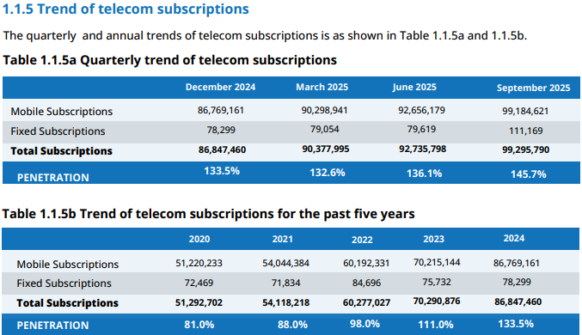

Slide 4
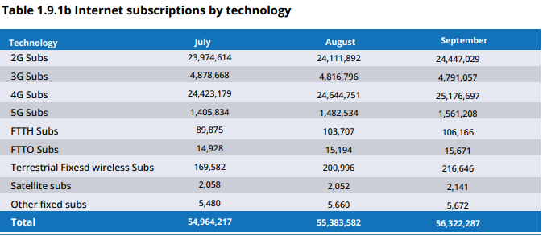

Slide 5
Opportunity
Tanzania has millions of internet users, but most rely on mobile data that is slow, expensive, and not designed for real broadband use. Fixed, high-quality internet is still limited to small urban zones, leaving households, students, and businesses underserved.
At the same time, a young and fast-growing population is demanding digital access for education, work, and entrepreneurship.
This creates a clear opportunity:
to deliver affordable, reliable wireless broadband that turns connectivity into real economic and social value.
SkyArt Networks Limited exists to close this gap — enabling Tanzania’s youth and communities to fully participate in the digital economy.

Slide 6
Market
Affordable wireless broadband services can convert mobile-only users into high-value fixed broadband users, opening revenue streams from households, students, SMEs, and community hotspots.

Slide 7
Solution
SkyArt Networks Limited delivers affordable, reliable, high-capacity internet to communities that are underserved by traditional fiber and expensive options of access.
We do this through a wireless-first broadband model that combines:
Community Wi-Fi Hotspots for students, workers, and public spaces
Fixed Wireless Broadband for homes, SMEs, and institutions
Scalable network infrastructure using modern Wi-Fi, backhaul, and QoS technologies
Flexible, youth-friendly pricing that makes broadband affordable and accessible
By deploying wireless broadband where fiber is limited or too expensive, SkyArt transforms mobile-only users into true broadband users — enabling online learning, digital businesses, remote work, and modern services.
Result:
Wider coverage, lower cost, better quality — and a faster path to digital inclusion and economic growth in Tanzania.

Slide 8
Technology
Our network is built on:
High-capacity wireless backhaul (unlicensed spectrum) to connect sites and communities
Wi-Fi 5 & 6 access points & fixed wireless CPEs to deliver fast, stable connections to users
Centralized core network with routing, traffic management, and security
Quality of Service (QoS) and bandwidth control to ensure fair, predictable user experience
Remote monitoring and network management for uptime, security, and performance
This architecture allows SkyArt to deploy broadband quickly and cost-effectively in areas where fiber is slow or expensive, while still meeting TCRA’s standards for service quality, safety, and reliability.
The result: a modern, scalable wireless ISP platform ready to support thousands of users and future growth

Slide 9
Rollout-Phase 1 — Pilot and Licensing (2026)
Goal:
Prove service quality and compliance
Deploy initial core services (NOC, routers, billing, authentication)
Launch first hotspot zones in high-demand areas(3 streets)
Serve early customers (retail & small businesses)
Revenue starts immediately
Establish QoS, monitoring, and reporting for TCRA
📌 Outcome: Stable, compliant, revenue-generating ISP

Slide 10
Phase 2 — Residential & SME Expansion (2027 – 2028)
Goal:
Scale paying subscribers
Deploy fixed wireless base stations
Connect homes, offices, cyber cafés, and schools
Introduce business internet and managed Wi-Fi
Add peering & redundancy for reliability
📌 Outcome: Multi-service ISP with growing subscriber base(10 streets and 3 POPs)

Slide 11
Phase 3 — City-Level Coverage (2028 – 2029)
Goal:
Become a recognized local ISP
Expand to more districts (10 POPs & 20 Streets)
Add SD-WAN & enterprise packages
Improve backhaul capacity
Network becomes cash-flow positive
📌 Outcome: High-quality, profitable network

Slide 12
Phase 4 — Regional Scale (2029 – 2030)
Goal:
Infrastructure-grade operator
Expand beyond Dar es Salaam
Build inter-city wireless & fiber interconnects
Serve institutions, government, enterprises
Revenue exceeds TZS 300M/year
📌 Outcome: National-scale WISP aligned with Tanzania’s digital agenda(20+ POPs & 50+ streets)

Slide 13
Revenue Model Explanation
a) Residential subscriptions
  Core growth engine
  Monthly recurring revenue
  Predictable cash flows
b) Small business subscriptions
  Higher ARPU than residential
  Lower churn
  Improves overall margin quality
c) Hotspot access
  Early-stage cash flow
  Brand visibility
  Entry point for conversion to subscriptions
d) Add-on services
  Incremental revenue with minimal additional cost
  Margin-enhancing over time

Slide 14
SkyArt Networks 5 Year Financial Story
SkyArt is designed to scale using a low-cost, high-reach wireless model. This allows us to grow users much faster than traditional fiber operators while keeping capital costs low.

Slide 15
Year 1 — Market Entry & Proof
We focus on deploying:
Community Wi-Fi hotspots
Early residential fixed wireless users
Revenue is driven mainly by vouchers and entry-level subscriptions.

Slide 16
Year 1 — Market Entry & Proof
This phase proves:
  Demand exists
  Customers are willing to pay
  The network operates reliably
By the end of Year 1, SkyArt has:
  xxx of active users
  Steady monthly cashflow
  A working operational model

Slide 17
Financial Milestones in Year 1
Net profit Margin = 16%
Operating Profit Margin = 22%
Gross Operating Profit = 63%
Targeted Revenue = 46.5 Million
Percentage Hotspot sales = 66%
Percentage SME and residential sales = 33%
Percentage Add on services sales = 1%
Assets = TZS 48,000,000
Liabilities = TZS 34,000,000
Equity = TZS 14,000,000

Slide 18
Year 2 — Expansion & Profitability
We expand coverage to:
  More streets
  More neighborhoods
  More homes and SMEs
Residential subscriptions increase, raising average revenue per user (ARPU).
Operating costs grow slowly compared to revenue because the same infrastructure supports many more users.
At this stage:
  Monthly revenue grows strongly
  Fixed costs are covered
  SkyArt reaches operating profitability

Slide 19
Financial Milestones in Year 2
Net profit Margin = 19%
Operating Profit Margin = 27%
Gross Operating Profit = 60%
Targeted Revenue = TZS 136.9 Million
Percentage Hotspot sales = 45%
Percentage SME and residential sales = 53%
Percentage Add on services sales = 2 %
Assets = TZS 143,000,000
Liabilities = TZS 73,000,000
Equity = TZS 70,000,000

Slide 20
Year 3 — Network Scaling
SkyArt becomes a recognized local broadband provider.
We add:
  More base stations
  More POPs
  More institutional clients (schools, offices, training centers)
  Revenue now comes mostly from:
  Monthly subscriptions
  Long-term contracts
This inturn creates:
  Predictable income
  Lower churn
  Stronger cashflow

Slide 21
Financial Milestones in Year 3
Net profit Margin = 22%
Operating Profit Margin = 31%
Gross Operating Profit = 61%
Targeted Revenue = TZS 199 Million
Percentage Hotspot sales = 45.5%
Percentage SME and residential sales = 52%
Percentage Add on services sales = 2.5%
Assets = TZS 372,820,000.00
Liabilities = TZS 167,500,000.00
Equity = TZS 205,320,000.00

Slide 22
Year 4 and 5 Regional Growth & Stability
With a proven model, SkyArt:
  Expands into new districts
  Increases bandwidth capacity
  Onboards enterprise and government clients
The network achieves:
  High utilization
  Strong margins
  Stable, recurring revenue
At this stage SkyArt is:
A sustainable ISP
A valuable digital infrastructure company
A platform for national broadband expansion

Slide 23
Financial Milestones in Year 4
Net profit Margin = 29%
Operating Profit Margin = 41%
Gross Operating Profit = 64%
Targeted Revenue = 300 Million
Percentage Hotspot sales = 47%
Percentage SME and residential sales = 50%
Percentage Add on services sales = 3%
Assets =
Liabilities =
Equity =

Slide 24
Financial milestones in summary

Slide 25
National & Social Impact
SkyArt Networks will:
• Connect underserved communities
• Give students & schools affordable internet
• Enable SMEs, cyber cafés & online businesses
• Support e-Government and digital services
• Reduce the digital divide

Slide 26
Economic & Infrastructure Impact
SkyArt will:
• Create technical & sales jobs
• Invest in wireless & data infrastructure
• Generate taxable revenue
• Improve local telecom competition
• Support long-term network sustainability

Slide 27
Why SkyArt, Why Now, Why TCRA Should Approve This License
Why SkyArt?
Innovative, scalable wireless ISP solutions
Tailored services for SMEs, schools & underserved communities

Slide 28
Why Now?
Rapidly growing internet demand in Tanzania
Digital transformation in education, business & government
Affordable wireless & SD-WAN technology ready for deployment
Aligned with national ICT policy & inclusion goals

Slide 29
Why TCRA Should Approve
Expands connectivity in underserved areas
Compliant with TCRA regulations & quality standards
Creates jobs & supports SMEs & digital economy growth
Introduces modern, responsible telecom innovation

